Slide 1
Progressive Report
Sangwoo Kim
Department of Mechanical Engineering,
Gachon University, Korea
2022-08-10

Slide 2
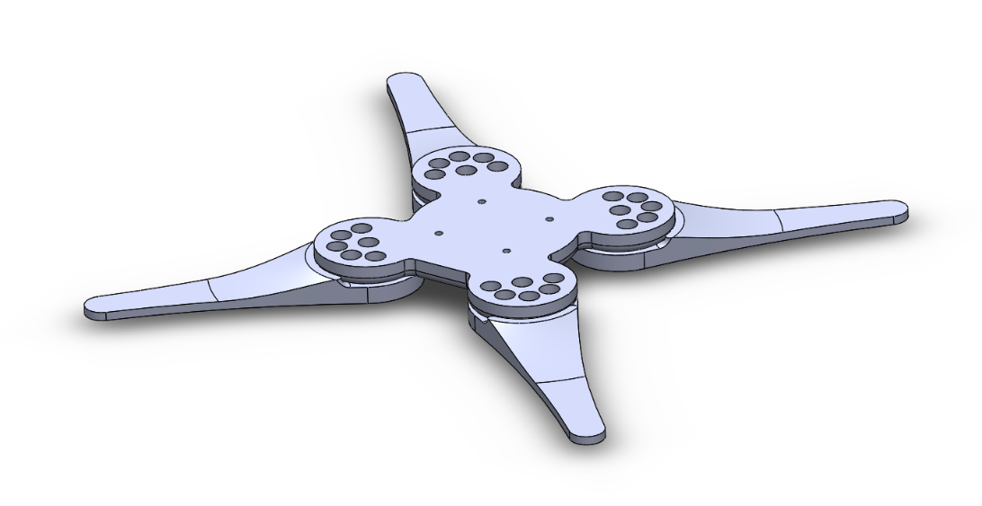
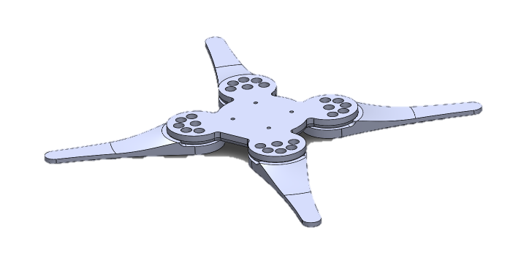
Robot bottom plate
Robot bottom design
It can be using with isolation-table and stand-alone mode both
Stand-alone assembely
Using stand alone

Slide 3
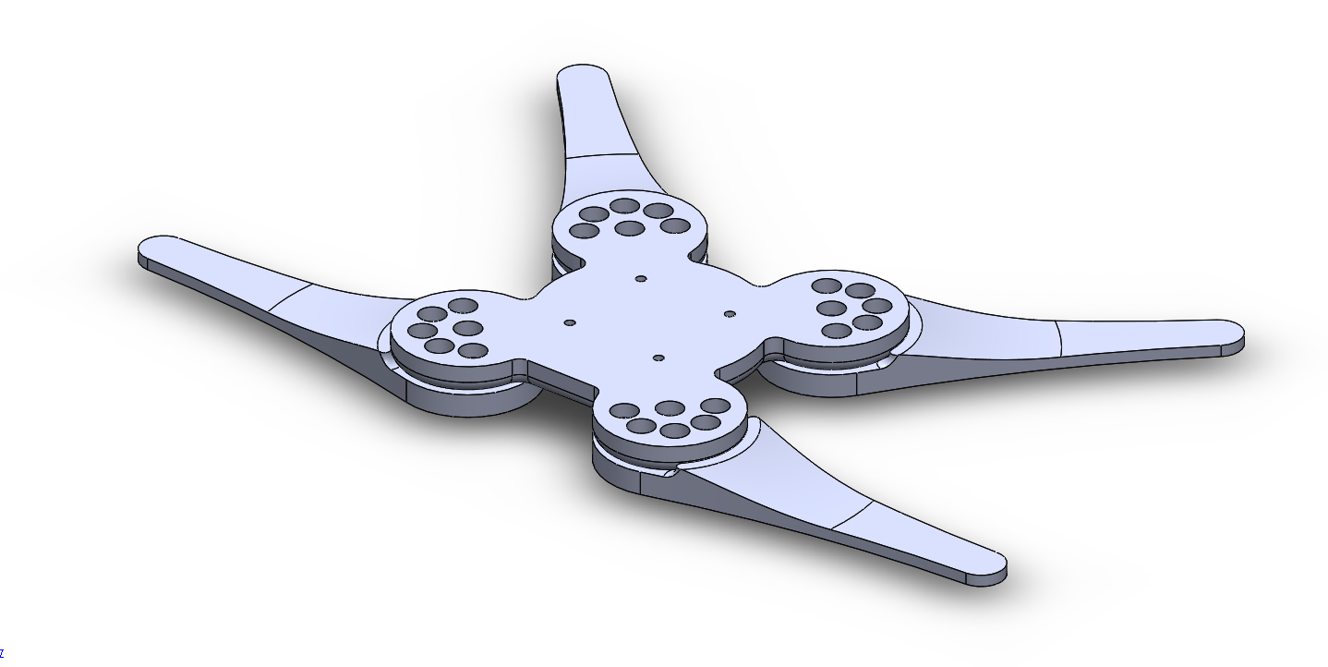
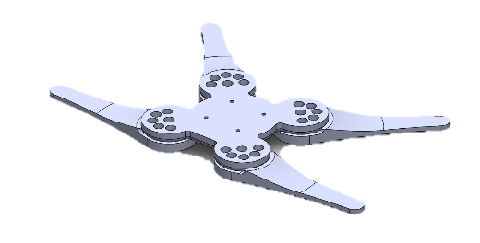
Robot bottom plate
Robot bottom design
Asymmetry assembely
Using with table

Slide 4
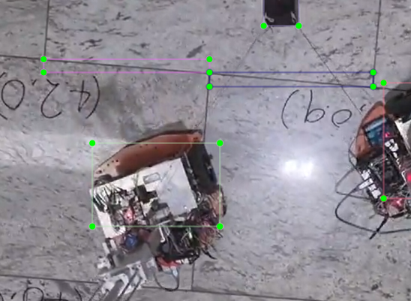
Video processing
Mathmethical base
Get origin point and scale vector
Geometrics relation of boxes and origin vector

Slide 5
Video processing
Mathmethical base
Get origin point and scale vector
dx element
dy element
orthogonal decomposition using inner product
of position vector to object

Slide 6
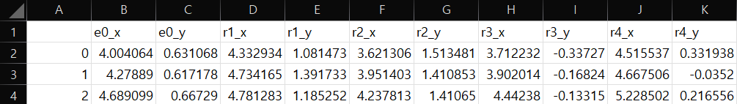
Video processing
Test result of 3 pictures
Export python result data using pandas to .csv
Test result
an end-effector and 4 robots
x, and y position list as csv data

Slide 7
Future works
Video processing with python

